Slide 1
Hand Gesture Recognition
Intelligent Interactive Systems
Group 7
Anil Poudel, Hosam Mohammed, Praveen Swamy and Uvais Karni
Notes:
Atabey

Slide 2
Goals
Implement the foundational part of the project consisting of the Landmark extraction, Gesture recognition and Responsive behavior.
Also, in this project the End-to-end learning was implemented as a part of the specialization component.
Notes:
Atabey

Slide 3
System Architecture
Foundational part -
Landmark extraction.
Gesture recognition.
Responsive behavior.
Specialization part -
End-to-end learning.
Notes:
Atabey

Slide 4
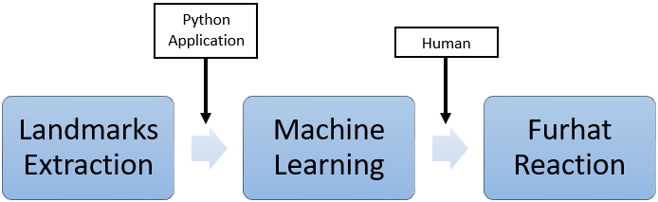

Slide 5
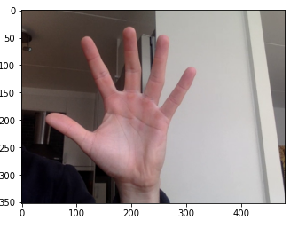
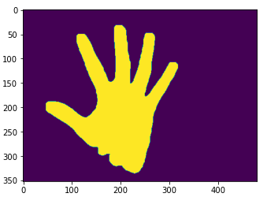
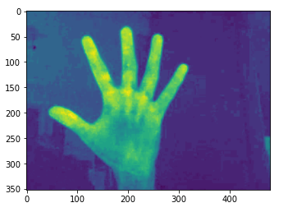
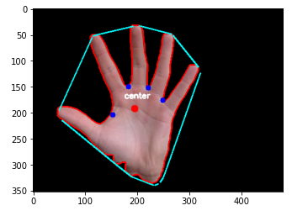
Hand Segmentation Using Cr Channel

Slide 6
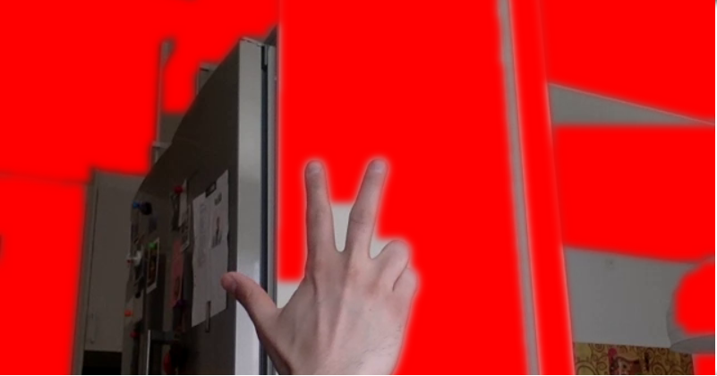
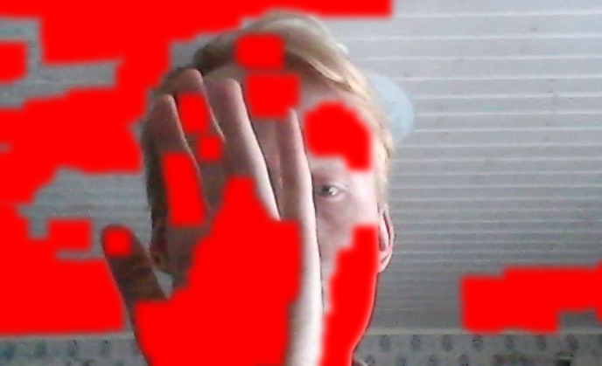
Background subtraction
Fig 3: Good result
Fig 4: Bad result

Slide 7
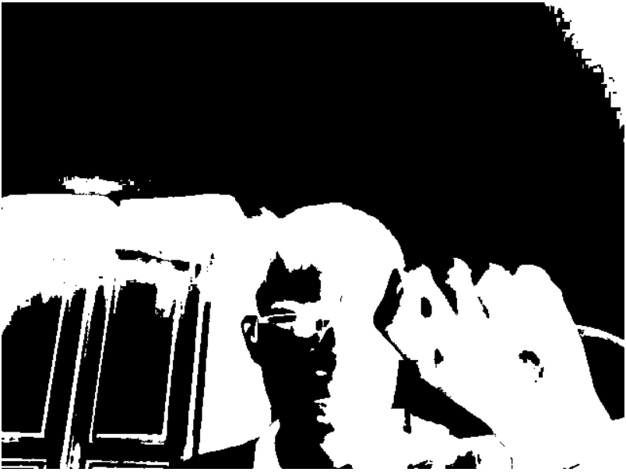
Adaptive thresholding

Slide 8
Subsystem 1 - Landmarks extraction
Load the hand-pose model
Read the frames
Preprocess the frames
Predict the keypoints using the model detector
Frame the key-points
Load the model trained in subsystem 2
Predict the gesture type

Slide 9
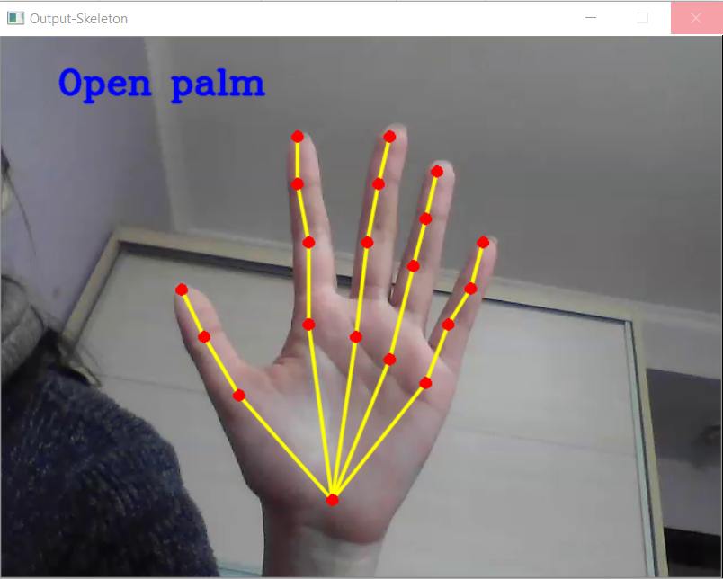
Results
Fig 1: Open palm output

Slide 10
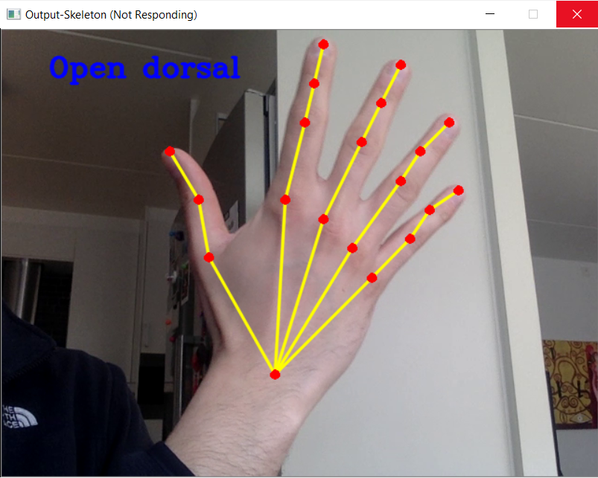
Fig 2: Open dorsal output

Slide 11
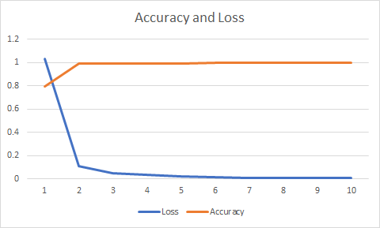
Subsystem 2 - Gesture recognition
Design the neural network model
Read the csv dataset
Split the dataset into train and test sets
Train the model
Evaluate the model and save

Slide 12
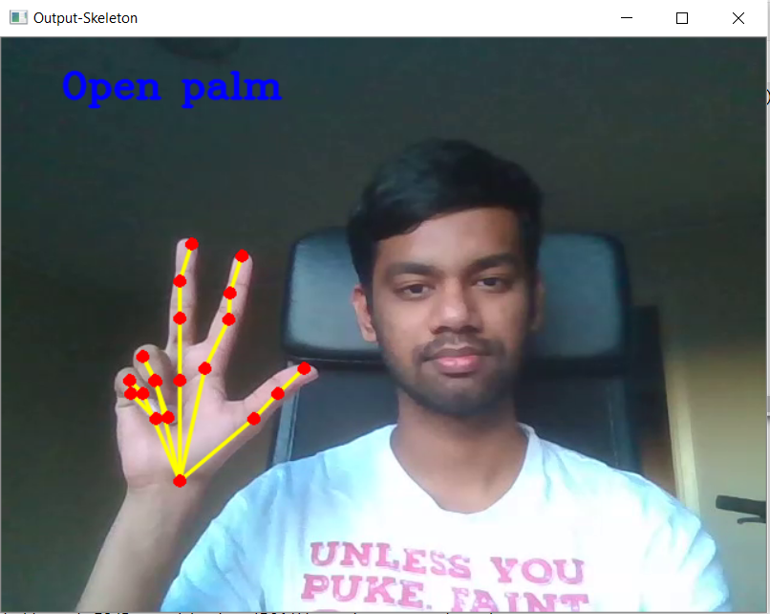
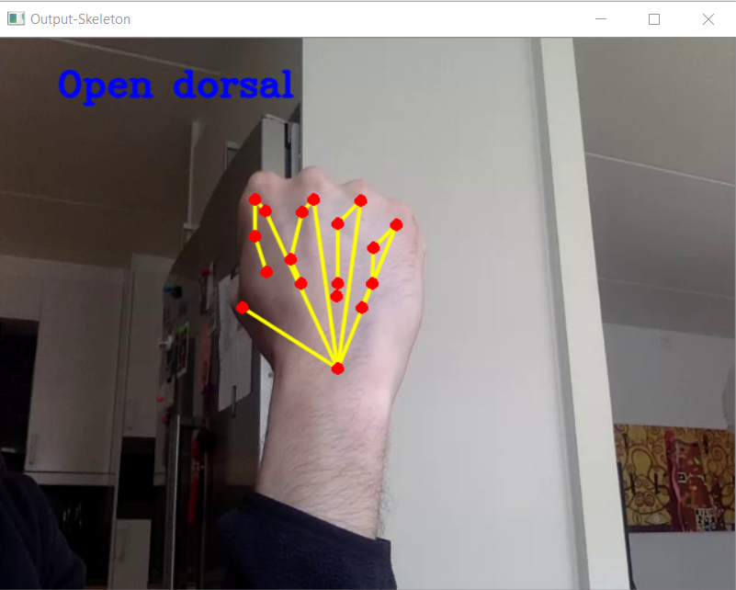
Issues
Fig 5: Incorrect gesture
Fig 6: Incorrect plotting
Notes:
Hosam

Slide 13
Third Subsystem
Furhat Virtual Robot.
Cotlin.

Slide 14
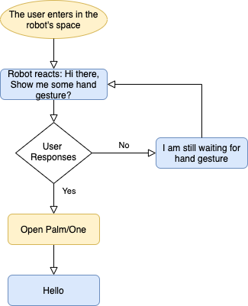
Interaction work flow

Slide 15

Demo

Slide 16
End to End System
Generate labels and bounding box
Region Proposal Network to Detect Object
2
5
Frames from Gesture Video
Generate Record File
Convolution Layers to Extract Features
Flatten and Dense Layer to Classify Detected Objects
3
4
6
1
Fast R-CNN

Slide 17
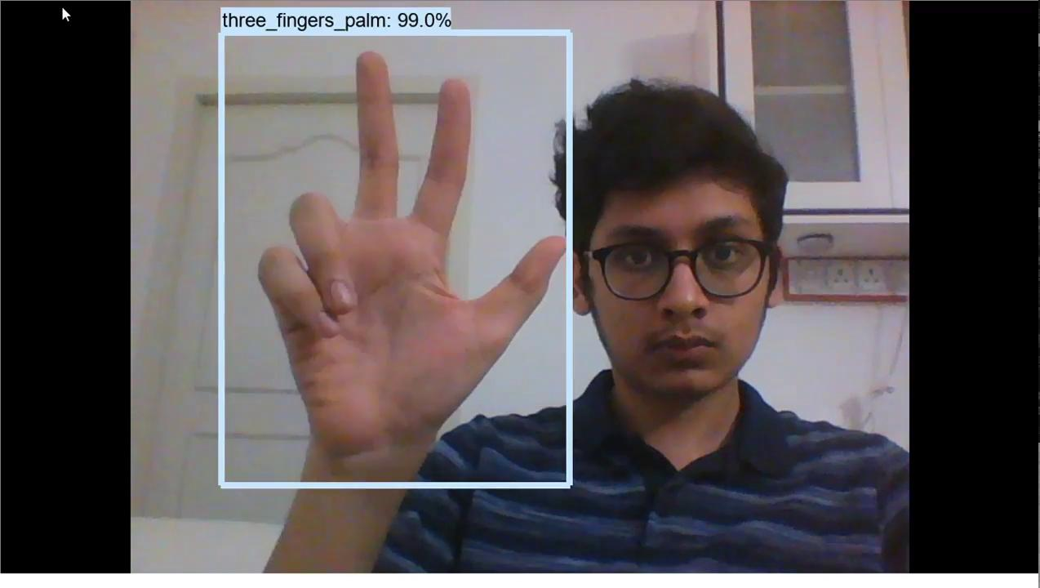
Hand Gesture Detection Demo

Slide 18
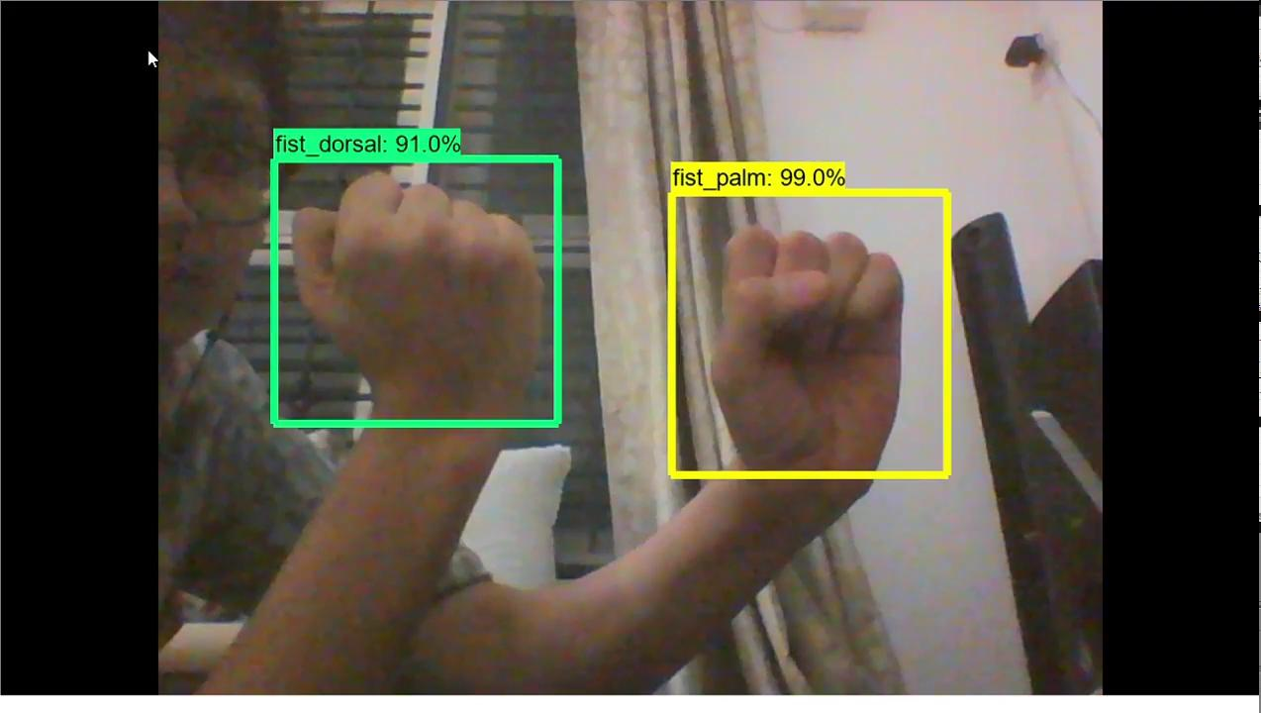
Multi-Hand Gesture Detection

Slide 19
Conclusion and future work
All three subsystems were successfully implemented along with the specialization part.
Future work constitutes of resolving the errors in gesture recognition and keypoint identification.
Notes:
Tom

Slide 20
Thanks!
Notes:
All

